Slide 1
EE 295 Final Presentation
FPGAs for Machine Learning
Dec, 2018
Name: Muhammad Aldacher

Slide 2
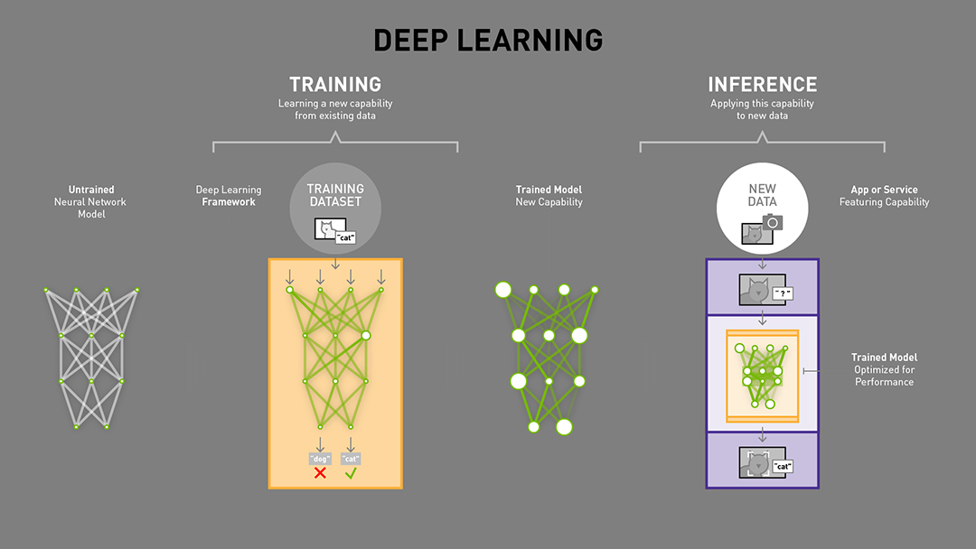
Machine Learning
Why Machine Learning needs special hardware ?

Slide 3
AI Accelerators
Special hardware used to speed-up AI-related tasks.
CPUs
ASICs
GPUs
FPGAs

Slide 4
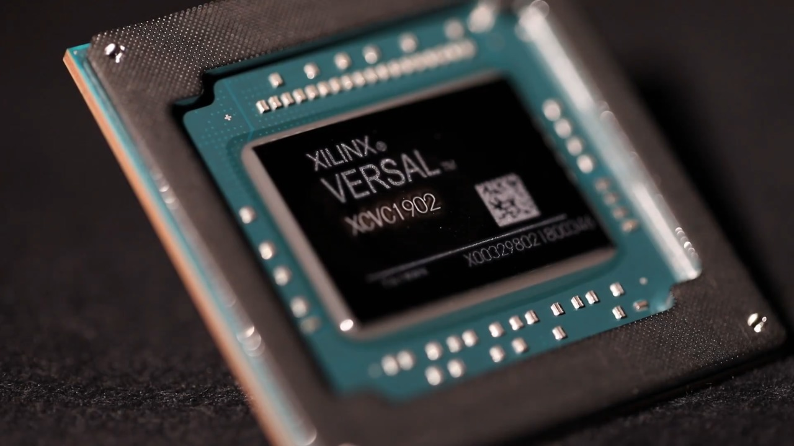
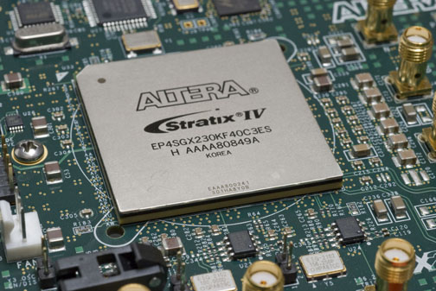
FPGAs
Why FPGAs for AI Acceleration ?
Flexibility
Multi-Level Parallelism
Dedicated Processors
Energy Efficiency

Slide 5
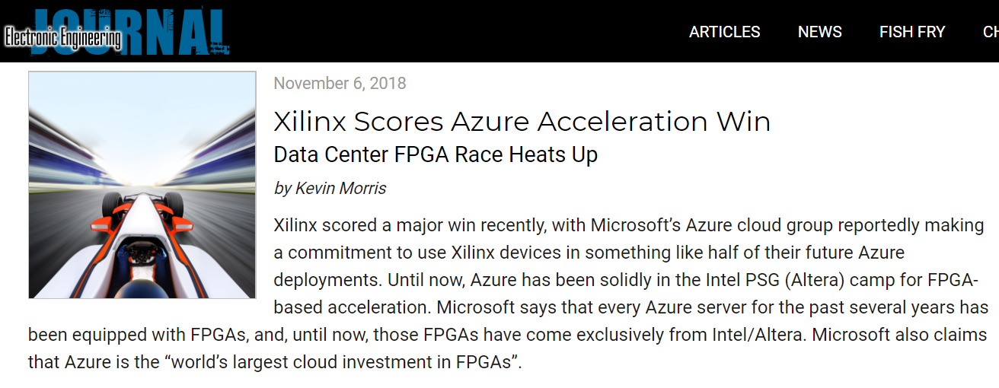
Market
Microsoft Data Centers
https://www.eejournal.com/article/xilinx-scores-azure-acceleration-win/

Slide 6
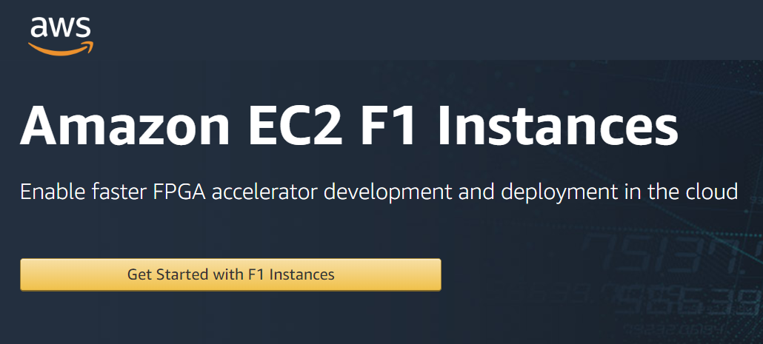
Market
Amazon Cloud Services
https://aws.amazon.com/ec2/instance-types/f1/

Slide 7
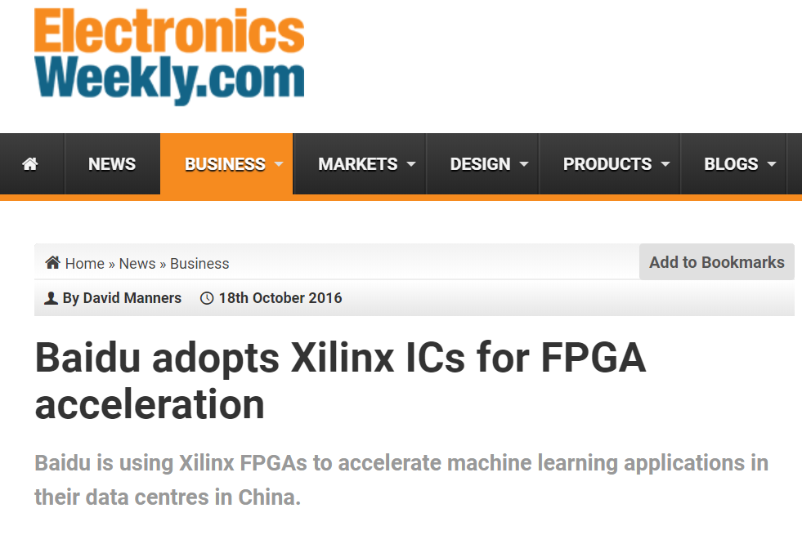
Market
Baidu AI Applications
https://www.electronicsweekly.com/news/business/baidu-adopts-xilinx-ics-fpga-acceleration-2016-10/

Slide 8
Conclusion
With the power and the flexibility offered by the new FPGAs like Xilinx’s Versal & Intel’s Agilex chip families, FPGAs can present a more powerful solution than GPUs for machine learning and AI applications, & can surpass the GPUs in market share in the coming years.

Slide 9
THANK YOU

